Slide 1
Non-Medical Personnel Radiation Awareness Training
Notes:
The thought of radiation exposure outside of the therapeutic setting can be a frightening one. Many of our perceptions of accidental radiation exposure stem from media coverage as well as Hollywood hype about the potential deadly effects of a large scale incident. The fact is that the controlled, calculated use of radiation saves far more lives on a daily basis than the total of all deaths from accidental exposures ever recorded.
Still, even with all the benefits of radiation, there is a real need to understand and prepare for instances of potentially lethal exposure. That’s why this course focuses on ionizing radiation; its dangers and protective measures.
Understanding both the capabilities of radiation as well as its limitations can minimize the anxiety associated with a radiation incident, and help you better prepare to help casualties of a mass radiological catastrophe.

Slide 2
Audience for Non-Medical Radiation Awareness
Are you a non-medical audience appropriate for the Non-Medical Radiation Awareness Training?
Non-medical hospital staff
(such as security, housekeeping, etc.)
If you need the full (medical) version of this course, Basic Radiation Training, close this lesson to access the alternate course. (You do not need to complete both versions of this course.)
Training Objectives for this Training
Describe the three main types of ionizing radiation
Differentiate between radioactive material and radiation
Name the primary sources of radiation
Differentiate between internal & external contamination and exposure
Explain the concept of shielding
Identify basics of biological effects of radiation
Notes:
This course is designed for the target audiences listed here.

Slide 3
Course Sections
Section 1
Radiation Basics
Section 2
Biological Effects of Radiation
Section 3
Exposure Versus Contamination
Section 4
Why This Matters to You and Your Hospital

Slide 4
Course Sections
Section 1
Section 1
Radiation Basics
Radiation Basics
Sources of radiation, both natural and man-made
Radioactive (ionizing) atoms emit radiation: alpha, beta and gamma
Section 2
Biological Effects of Radiation
Section 3
Exposure Versus Contamination & Shielding
Section 4
Implications for Hematopoietic Stem Cell Transplant and the RITN
Notes:
There are many sources of radiation that humans are constantly exposed to; some natural and some man-made.
There are three main types of ionizing radiation emitted from radioactive atoms: alpha, beta and gamma.
In this section you will begin to understand ionizing radiation (nuclear radiation) by learning how radioactive atoms emit radiation.

Slide 5
Natural Background Radiation
We are all exposed to radiation everyday from our environment.
Cosmic Radiation
Primarily from our sun. The Earth’s atmosphere shields the planet from most of this radiation.
Radioactivity in the Body
The body naturally contains very small quantities of radioactive substances.
Terrestrial Sources
Earth has naturally occurring radioactive material found in the soil that, as it breaks down, becomes radon gas that can seep into buildings – usually at low levels. About 1/3 of our exposure to natural radiation comes from radon.
Notes:
Most people are unaware that they are exposed to very low levels of radiation every day from their environment. First, let’s explore sources of natural radiation.
There are three main sources of natural background radiation. The first type we’ll discuss, cosmic radiation, mainly occurs in the form of radiation from our sun, most of which is shielded by the earth’s atmosphere.
Even the human body naturally contains very small quantities of radioactive substances.
The earth also has naturally occurring radioactive material found in the soil. As these materials breakdown, they become radon gas that can seep into buildings in some regions, usually at low levels. About one third of our exposure to natural radiation comes from radon.

Slide 6
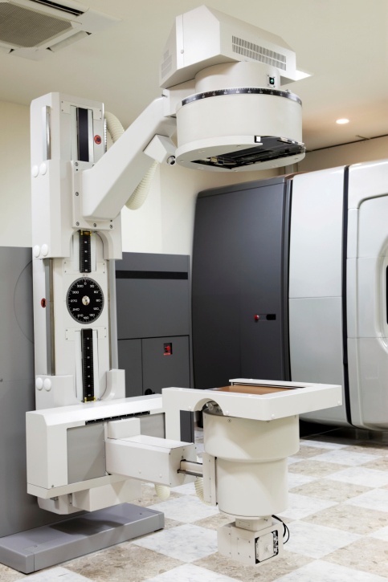
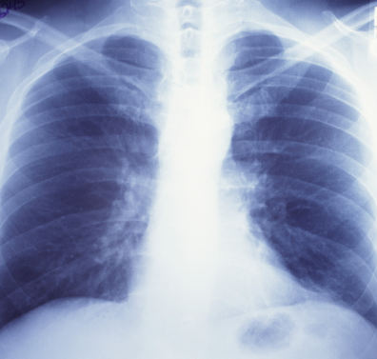
Man-made Sources of Radiation
Therapeutic Radiology:
Radioactive material used to treat a patient’s condition (e.g. cancer therapy)
Diagnostic Radiology:
Exposure from procedures to determine a medical condition (e.g. X-rays)
Other Sources:
Includes fallout from military experiments, occupational exposure, & other miscellaneous sources
Notes:
Man-made sources of radiation account for a smaller portion of the exposure to humans on a daily basis.
Therapeutic radiology is radioactive material used to treat a patient’s condition, such as a cancer therapy.
Diagnostic radiology refers to exposure from medical procedures to determine a patient’s medical condition, such as with X-rays or bone scans.
Other sources include fallout from military experiments, occupational exposure, and other miscellaneous sources.
Despite the number of man-made radiation sources, the amounts of exposure are generally very limited, resulting in very little effect on the human body, most of which comes from X-ray.

Slide 7
Natural and Man-made Radiation Sources
Radiation should not be feared but respected. Why?
It is always in the environment
OR
It is used regularly in medical
treatment/diagnostics or manufacturing
Chart created based on data from “Ionizing Radiation Exposure of the Population of the United States: Recommendations of the National Council on Radiation Protection and Measures,” NCRP Report, Vol. 160 (March 3, 2009): pp. 11.
Notes:
This chart outlines the sources of natural and man-made radiation found around us.
The typical reaction to any radiation is one of fear. Now that you are becoming more familiar with the many sources of natural and man-made radiation around you, try to keep in mind that not all sources of radiation should be feared. It is always present to some extent in our environment and is used regularly for our benefit in the medical field.

Slide 8
Radioactivity & Ionizing Radiation
Unstable atoms undergo nuclear processes that cause them to become more stable.
The process of emitting excess energy from the nucleus
is called radioactive decay.
Unstable
(radioactive)
atom
Alpha
Decay
Beta
Gamma
Excess energy released is called
ionizing radiation
Notes:
Everything in nature would prefer to be in a relaxed, stable state. Unstable atoms undergo nuclear processes that cause them to become more stable. One such process involves emitting excess energy from the atom’s nucleus. This process is called radioactivity or radioactive decay.
The released, excess energy is called ionizing radiation, of which there are three main types; Alpha, Beta and Gamma.
Alpha, Beta, and Gamma particles come from the natural break-down processes that occur as atoms age, releasing one or more of these dangerous forms of radiation.
The terms “radiation” and “radioactive” are often confused. To help, you can keep the following phrase in mind: Radioactive atoms emit radiation.

Slide 9
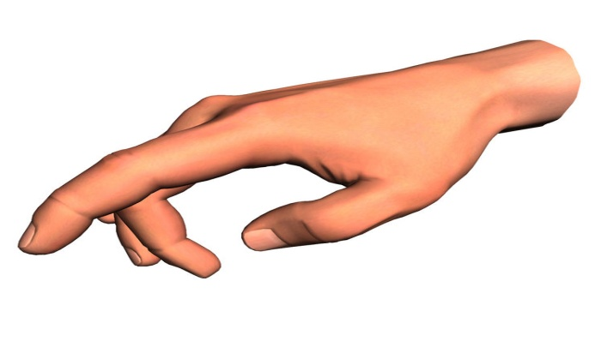
Alpha, Beta, Gamma
Ionizing radiation can be a hazard if ingested inside the body through eating food, breathing air or drinking water with radioactive material in it.
0
Skin Aluminum Lead Concrete
Alpha Particles
Beta Particles
Gamma Rays
Notes:
Alpha, beta and gamma radiation can be hazardous if ingested inside
Let’s learn about the three types of ionizing radiation, Alpha, Beta, and Gamma rays, in greater detail.
Alpha particles are the heaviest and most highly charged of the ionizing radiations. Without additional energy input, these characteristics make alpha particles less penetrating than beta particles and gamma rays. Their energy is used up before they get very far. Alpha particles cannot travel more than four to seven inches (10 to 18 cm) in air and are completely stopped by an ordinary sheet of paper. Their energy is spent interacting with the charged protons and electrons they meet near any surface they strike.
Even the most energetic alpha particle from radioactive decay can be stopped by the outermost layer of dead skin that covers the body. Therefore, exposure to most alpha particles originating outside the body is not a serious hazard.
On the other hand, if alpha-emitting radioactive materials are taken inside the body, they can be the most damaging source of radiation exposure. The short range of the alpha particle causes the damaging effects of the Radiation to be concentrated in a very localized area.
Beta Particles
Beta particles are smaller and travel much faster than alpha particles. They are physically similar to electrons, but they are not in orbit around an atom. Since beta particles travel faster and have less charge than alpha particles, they penetrate further into any material or tissue. Typical beta particles can travel several millimeters through tissue, but they generally do not penetrate far enough to reach the vital inner organs. Beta particles may be a major hazard when emitted by internally-deposited radioactive material or when interacting with the lens of the eye.
Exposure to beta particles from outside the body is normally thought of as a slight hazard. However, if the skin is exposed to large amounts of beta radiation for long periods of time, skin burns similar to heat burns may result. If removed from the skin shortly after exposure, beta-emitting materials will not cause serious burns and will not pose a severe external hazard.
Like alpha particles, beta particles are considered to be an Internal hazard if taken into the body by eating food, drinking water, or breathing air containing radioactive material. Beta Emitting contamination can also enter the body through unprotected open wounds.
Gamma rays are similar to medical x-rays. Gamma rays are a type of electromagnetic radiation, with energy transmitted through space in the form of waves. Different types of electromagnetic radiation have unique physical characteristics, which are measured in wavelength and frequency. Short wavelength and high frequency are characteristic of gamma and x-rays.
Gamma rays are the most hazardous type of radiation from sources outside the body because they can travel much greater distances through air and all types of material. Gamma rays can travel up to a mile (1.6 km) in open air and may present a significant hazard even at fairly large distances. Since gamma rays penetrate more deeply through the body than alpha or beta particles, all tissues and organs can be damaged by sources outside of the body.
In many cases, some type of dense material is needed to reduce the hazard presented by gamma rays. Any material between the radiation source and the receptor (i.e., the person or object receiving the radiation) is called shielding, because it absorbs some of the gamma ray energy before it can penetrate. For example, 2-1/2 inches (6 cm) of dense concrete will absorb approximately 50 percent of typical gamma rays. Five inches (13 cm) of water is just as effective.
the body through eating food, breathing air or drinking water that has been contaminated with radioactive material.

Slide 10
Alpha, Beta, Gamma
Ionizing radiation can be a hazard if ingested inside the body through eating food, breathing air or drinking water with radioactive material in it.
There are many forms of radiation, most of which are not dangerous. Alpha, Beta, and Gamma rays are on the ionizing end of the chart below.
Source: https://www.wikihow.com/Understand-the-Electromagnetic-Spectrum
Notes:
It’s important to realize that not all forms of radiation are dangerous. This chart shows ionizing radiation types on the far right side, while the safer types of radiation we experience everyday are listed on the left.

Slide 11
Test Your Knowledge 1
Because of its low penetrating ability, the type of radiation which is usually only a hazard when inhaled or ingested is:
A: Alpha Radiation
B: Beta Radiation
C: Gamma Radiation
D: Neutron Radiation
Notes:
A: Alpha Radiation

Slide 12
Course Sections
Section 1
Section 2
Radiation Basics
Biological Effects of Radiation
Acute vs. chronic exposure
Biological factors
Long-term effects of radiation
Section 2
Biological Effects of Radiation
Section 3
Exposure Versus Contamination & Shielding
Section 4
Implications for Hematopoietic Stem Cell Transplant and the RITN
Notes:
The biological effects of radiation exposure depend on several key factors. The type of exposure, level of exposure, and certain biological factors will all play a role in determining the effects it will have on an individual.
In this section you will learn to distinguish between acute and chronic exposure and how biological factors can influence its effects.

Slide 13
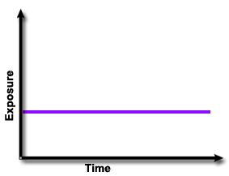
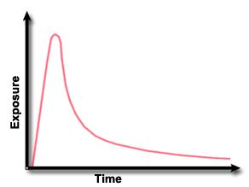
Acute vs. Chronic Exposure
Acute
Occurs in a short period
of time
Can result in a large
Dose
Examples:
Bone Scans
Nuclear power plant accident
Chronic
Occurs over a long
period of time.
Usually small doses
Examples:
Natural Background
Radiation
Occupational Radiation
The dose of radiation is not directly linked to the length of exposure.
Notes:
Exposure to radiation received within a short period of time is known as acute exposure. While this can sometimes occur in large, accidental doses, there are many familiar examples of acute exposure, such as medical bone scans or dental X-rays.
Exposure to radiation on a continuous or repetitive basis is known as chronic exposure. Generally, these are small doses of exposure over a long period of time. Some examples of chronic exposure would be natural background radiation and occupational radiation.
It’s important to note that the dose of radiation is not directly linked to the length of exposure.

Slide 14
Biological Effects
Ionization
Notes:
To understand the types of biological effects resulting from exposure to ionizing radiation, it is important to understand how radiation interacts with the body.
Remember, radiation is a form of energy in motion. When alpha, beta and gamma radiation enter the body, some or all of their energy is lost in collisions with the body’s atoms. This strips electrons away from atoms in the body in a process called ionization. For this reason, alpha, beta, and gamma radiation is often called ionizing radiation.
Ionization can damage DNA and other structures inside the body’s cells. In some cases, the damage to the cells can be so great that the cell is incapable of repairing itself, resulting in cell death. Alternately, damage to DNA may be repaired incorrectly, resulting in mutations that could ultimately result in cancer. Surprisingly though, data has shown that acute radiation exposure only marginally increases cancer risk.
A study of 82,000 Japanese atomic bomb survivors, each receiving an average exposure of approximately 28 rads, revealed that only 0.2 percent experienced a radiation-induced cancer.

Slide 15
Biological Factors
Two people exposed to the same amount of ionizing radiation
may experience different symptoms.
Factors that could influence the effects of radiation:
Age
Sex
Diet
Body Temperature
Overall Medical Health
Notes:
Each person differs in their biological response to a given dose of radiation. Theses differences can mean that, except at extremely high acute doses, two people exposed to the same amount of ionizing radiation may experience different symptoms. Several factors which may influence the effect of radiation on any given person are his or her age, sex, diet, body temperature and overall medical health.

Slide 16
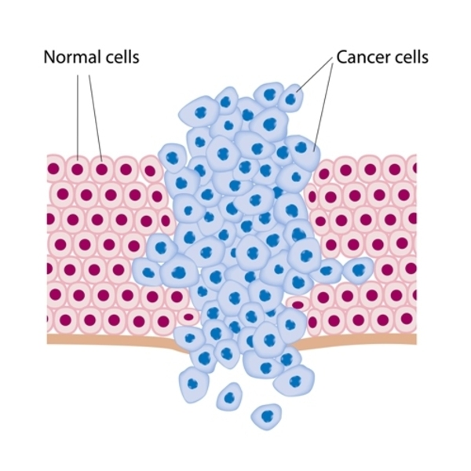
Biological Effects
Long-term Effects
Cancer
Acute radiation exposure only marginally increases cancer risk. The National Academy of Sciences BEIR VII committee has generally estimated population long-term risks to be around 5% per Sievert (a unit of measure), although risks are increased for women and children.

Slide 17
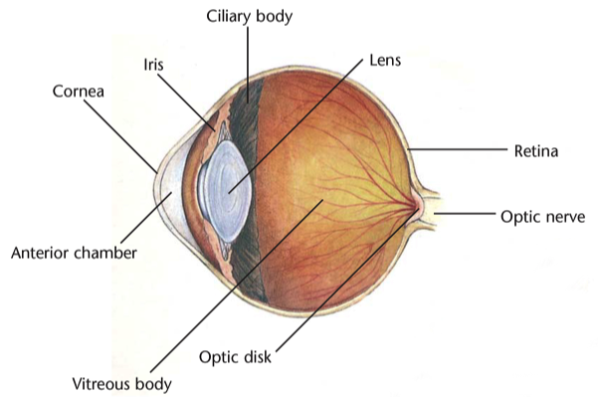
Biological Effects
Cataracts
The fibers that comprise the lens of the eye are specialized to transmit light. Damage to these fibers can result in dark spots in the lens called cataracts.

Slide 18
Biological Effects
Lifespan
Experiments with animals indicate that exposure to radiation can result in a shortened lifespan. Irradiated animals appear to die of the same disease as non-irradiated animals, but they do so at an earlier age. Data from the populations of Hiroshima and Nagasaki indicate that life-span shortening in humans is very slight.

Slide 19
Test Your Knowledge 2
Chronic exposures are:
A: Amounts of radiation received over a short period of time
B: Amounts of radiation received over a very long period of time
C: Acute exposures which affect only critical organs of the body
D: Acute exposures which affect all parts of the body
Notes:
B: Amounts of radiation received over a very long period of time

Slide 20
Test Your Knowledge 2
High levels of ionizing radiation exposure can result in which long-term effect?
A: Nausea
B: Restlessness
C: High fever
D: Increased risk of cancer
Notes:
D: Increased risk of cancer

Slide 21
Course Sections
Section 1
Section 3
Radiation Basics
Exposure Vs. Contamination
Radiation exposure
Radioactive contamination
Exposure control techniques
Section 2
Biological Effects of Radiation
Section 3
Exposure Versus Contamination & Shielding
Section 4
Implications for Hematopoietic Stem Cell Transplant and the RITN
Notes:
There is a distinct difference between radiation exposure and radioactive contamination. In this section you will learn to distinguish the two and then test your knowledge. In addition, you will learn how to minimize radiation exposure using three protective factors— time, distance, and shielding. Let’s get started.

Slide 22
Contamination vs. Exposure
When you are exposed to radiation, the radiation does its damage, expends its energy, and is gone.
If you carry contamination on your clothes or body, the material continues to emit radiation as long as it is radioactive.
Exposure
Man standing next to a spill of radioactive material. He does not come in contact with or inhale the material.
Is he contaminated?
YES
NO
Man comes in contact with radioactive material when it splashes on his clothing. He removes the clothing & showers.
Is he contaminated?
YES
NO
Man accidentally wipes his mouth with his hand after radioactive material splashed on it. He leaves scene with some of the material on his coat.
Is he contaminated?
YES
NO
Notes:
It is important to understand that you can be exposed to radiation without becoming contaminated. When you are exposed to radiation, the radiation does its damage, expends all its energy, and is gone. If you carry contamination on your clothes or body, the material continues to emit radiation as long as it is radioactive.
With this in mind, read the following scenarios and select the ‘yes’ or ‘no’ to answer the questions.
Presenter: Answers to ‘Are You Contaminated?’
Standing next to spill, you are NOT
If you stand next to contamination, you will be exposed to radiation. However, while the floor is contaminated, you are not. As long as you don't get the contamination on your body or clothes, or in your lungs, you can walk away and leave the source of radiation behind.
Pathways for radiation contamination include inhalation from air particles, skin contamination, and food, water or milk ingestion.
If you think you’ve come in contact with radiative materials, follow your hospital’s standard operating procedures.
Splashes on clothing, you ARE
If you get contamination on your body or clothes, you will continue to be exposed to radiation until you wash the contamination off. The radioactive material continues to emit radiation, but you are no longer carrying it with you.
Radioactive contamination on a surface does not make the surface itself radioactive. The particles themselves are radioactive, not the surface they come in contact with. The surface can usually be cleaned of any contamination.
If you think you’ve come in contact with radiative materials, follow your hospital’s standard operating procedures.
Wipes mouth after splash, you are NOT
Airborne radioactive materials may also present an internal exposure hazard if inhaled, ingested or internalized by injury with radioactive shrapnel. Internal material, in addition to directly providing a local dose (e.g. to the lungs after inhalation), contains certain elements that concentrate in particular organs (e.g., lungs, bones, or thyroid) and thus become a special threat to those organs.
It is unlikely that enough fallout particles could be inhaled into the lungs to cause significant harm. If it’s very dusty, a folded cloth over the nose and mouth may act as a filter. This can prevent some ingestion or inhalation of the fallout particles. Ingestion can occur when radioactive particles deposited on the ground may be eaten by grazing cattle whose meat or milk is consumed by man.

Slide 23
Exposure Control Techniques
There are three important factors that protect you from the effects of radiation:
Time, Distance and Shielding
Time
Less time = less exposure
Radiation levels naturally decrease
due to radioactive decay
Distance from
radiation source
Shielding
Time
Distance
More distance = less exposure
Intensity of radiation field decreases exponentially as
distance increases
Shielding
More shielding material = less exposure
Intensity of radiation reduced by absorption and scattering
Gamma is shielded by dense material, such as lead
Beta is shielded by wood or plastic
Alpha is shielded by almost any material
Notes:
In a radiation incident, using exposure control techniques can help protect you and minimize your exposure. There are three important factors in protecting individuals from the effects of radiation: time, distance and shielding.
The less time an individual remains in a radiation field, the less exposure that individual will receive. Radiation levels naturally decrease due to radioactive decay.
The further an individual remains from a radiation source, the less exposure that individual will receive. The intensity of a radiation field decreases exponentially as the distance from the source increases.
The more shielding material placed between an individual and a radiation source, the less exposure that individual will receive. The intensity of a radiation beam is reduced by absorption and scattering with the material. For gamma radiation, dense material such as lead is most effective as a shield. Beta radiation can be shielded by relatively thin amounts of wood or plastic. Alpha is shielded by virtually any material.

Slide 24
Rate of Exposure Considerations
Distance from
radiation source
Shielding
Time
< 1 | 4-15 | 10 | 24 | 50 | 70 | 200 | 620
Living near a normally functioning nuclear power plant (annual)¹ | Dental x-ray (single event)² | Chest x-ray (single event)² | Exposure to cosmic radiation living at sea level (annual)¹ | Exposure to cosmic radiation living in Denver (annual)¹ | Mammogram (single event)² | Radon in average home (annual)¹ | One year of exposure to natural radiation (from soil, cosmic rays, etc.)²
 |  |  |  |  | ¹ www.epa.gov/rpdweb00/understand/perspective.html ² www.bt.cdc.gov/radiation/pdf/measurement.pdf
Notes:
Not only is it important to control one’s exposure to radiation, but also the rate of one’s exposure. As illustrated by this chart, just living in our environment for a year results in enough radiation exposure to be dangerous if it were received all at once, but because it’s spread out over the year, it has far less effect on our health than a single event exposure might.
A good analogy is to think of exposure rate like the flow of water out of a hose. You could stand in front of a steady stream of water from a garden hose for 30 minutes, and it would have far less effect on you than being in front of a fire hose for a few seconds. However, the same fire hose would have little to no effect if you where shielded by a brick wall, or a mile away from the hose. This is an example of the important role that time, distance, and shielding can play on minimizing a potential exposure.

Slide 25
Test Your Knowledge 3
Radioactive fallout and other forms of external contamination make the surfaces they come into contact with radioactive.
True
False
Notes:
False

Slide 26
Test Your Knowledge 3
Radiation levels naturally decrease due to radioactive ____________.
A: Decay
B: Decontamination
C: Equilibrium
D: Absorption
Notes:
A: Decay

Slide 27
Course Sections
Section 1
Section 4
Radiation Basics
Why This Matters to You and Your Hospital
Radiation disasters
How to detect radiation
Section 2
Biological Effects of Radiation
Section 3
Exposure Versus Contamination & Shielding
Section 4
Implications for Hematopoietic Stem Cell Transplant and the RITN
Notes:
So why does this matter to you and your hospital?
The number and severity of casualties after a radiologic incident is difficult to predict. Like all disasters, there is a worst case scenario, a best case and many variations in-between. But we do know that radiation, even at low doses, will affect marrow first. As a result, your hospital could receive casualties for specialized care following a radiologic incident, even from across the country.
In this section you will learn about the public dangers that could result from radiation disasters and how to detect radiation.

Slide 28
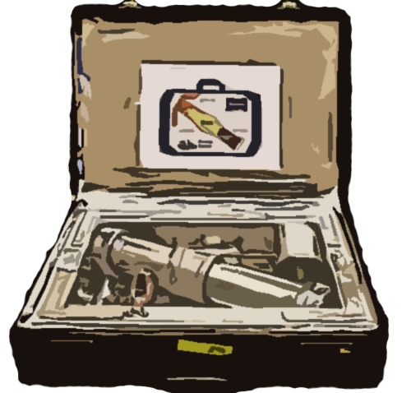
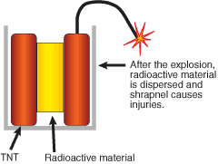
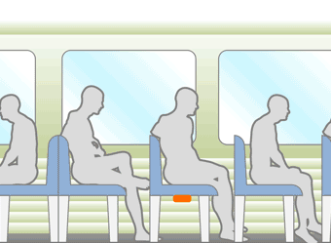
Radiation Disasters
Improvised Nuclear Device (IND)
Radiological Dispersal Device (RDD)
Radiological Exposure Device (RED)
See ‘What Kind of Emergency?’ @ www.remm.nlm.gov
for more information.
Source: Radiation Emergency Medical Management - http://www.remm.nlm.gov/
Notes:
Radiological disasters take many forms such as an improvised nuclear device, a radiological dispersal device, or a radiological exposure device. The one you may be more familiar with is the radiological dispersal device, or dirty bomb. For more information on any of these types of radiological devices, go to the Radiation Emergency Medical Management website which is listed on this slide.
Dangers resulting from these include:
Potential to affect hundreds of thousands of people and exceed communities’ resources
Widespread public panic and mass confusion
Significant economic impact
May receive casualties over extended periods of time

Slide 29
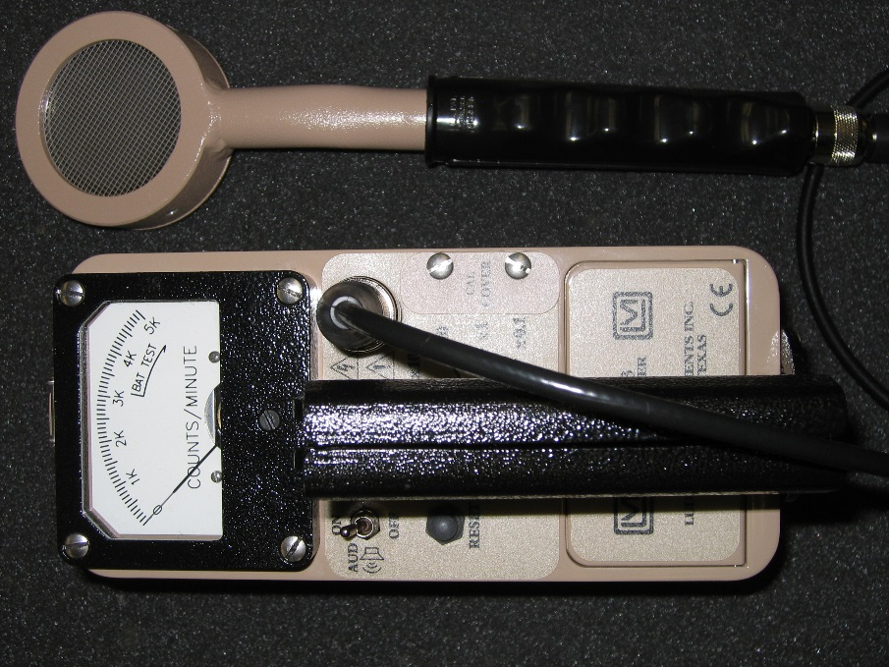
How to Detect Radiation
Radiation is:
Cannot detect with sight, smell, sound, touch or taste
Easily detected unlike bacterial contamination often found in hospitals
May be detected and measured using specialized equipment like a Geiger Counter
Source: Mark Jenkins, PhD, CSP at REAC/TS

Slide 30
Summary – Alpha, Beta, Gamma
0
Skin Aluminum Lead Concrete
Alpha Particles
Beta Particles
Gamma Rays
Notes:
Ionizing Radiation
The three types of ionizing radiation are alpha, beta and gamma. Alpha particles are low energy and can be stopped by a piece of paper, where Beta particles are a little higher energy and are stopped by aluminum foil. Both are dangerous if ingested. Gamma rays are very high energy and pass through the body. It takes lead, cement, or a brick wall to stop Gamma rays.

Slide 31
Natural Background Radiation
Man-made Sources of Radiation
Notes:
Radiation Sources
Natural (cosmic radiation, terrestrial sources, and radioactivity in the body)
Man-made (diagnostic radiology, therapeutic radiology, and other man-made sources)

Slide 32
Biological Factors
Factors that could influence the effects of radiation:
Age
Sex
Diet
Body Temperature
Overall Medical Health
Notes:
Biological Effects
Although the effects of exposure to large groups can be predicted, each individual's body differs. These differences can mean that two people exposed to the same amount of ionizing radiation may experience different complications. Biological factors that may influence the effect of radiation on an individual include age, sex, diet, and health.

Slide 33
Contamination vs. Exposure
Notes:
Radiation Exposure
When one is exposed to radiation, the radiation does its damage, expends all its energy, and is gone. If contamination is carried on clothes or the body, the material continues to emit radiation as long as it is radioactive. Internal contamination is inhaled, ingested or internalized by radioactive shrapnel. External contamination can be easily removed.

Slide 34
Time, Distance, Shielding
Distance from
radiation source
Shielding
Time
Notes:
Exposure Reduction
There are three ways to reduce the level of exposure to radiation: Time, Distance, and Shielding.
Reducing the amount of time near the radioactive material, increasing the distance between you and the radioactive material or inserting something between you and the radiation (shielding) all reduce the level of exposure.

Slide 35
Test Your Knowledge 4
The three main types of ionizing radiation are:
A: Microwave, X-ray, gamma
B: Alpha, gamma, neutron
C: Beta, gamma, neutron
D: Alpha, beta, gamma
Notes:
D: Alpha, beta, gamma

Slide 36
Test Your Knowledge 4
Radioactivity is the process where unstable atoms disintegrate or decay to stable atoms. The energy released in this process is called:
A: The blast effect
B: The shock wave
C: A mushroom cloud
D: Ionizing radiation
Notes:
D: Ionizing radiation

Slide 37
Test Your Knowledge 4
Radiation received by the body over a short period is:
A: Chronic exposure
B: Sublethal exposure
C: Acute exposure
D: Supralethal exposure
Notes:
C: Acute exposure

Slide 38
Test Your Knowledge 4
Almost the entire world population's dose from radioactivity comes from ______ sources.
A: Radon
B: Natural
C: Nuclear medicine
D: Artificial
Notes:
B: Natural

Slide 39
Test Your Knowledge 4
The source of most of the annual dose from natural sources of radiation is from what?
A: Radon
B: Lead
C: The sun
D: Consumer products
Notes:
A: Radon

Slide 40
Test Your Knowledge 4
The most common medical procedure leading to an individual's collective dose of radiation is what?
A: Radiotherapy
B: Filling a cavity
C: Blood pressure check
D: X-ray
Notes:
D: X-ray

Slide 41
Test Your Knowledge 4
When radioactive particles land on a surface, the original surface:
A: Becomes permanently radioactive
B: Becomes radioactive for a limited period of time
C: Is considered contaminated, but does not become radioactive
D: Is unaffected and is safe to walk about
Notes:
C: Is considered contaminated, but does not become radioactive

