Slide 1
Radiation Injury Treatment Network
<INSERT SPEAKER CONTACT INFO HERE>
Refer to notes for talking points and draft script.
RITN@nmdp.org
www.RITN.net
<as of Feb 2023>
Notes:
RITN Green Color:
PPT RGB definition
Green: 166-206-57
Yellow: 255-242-0

Slide 2
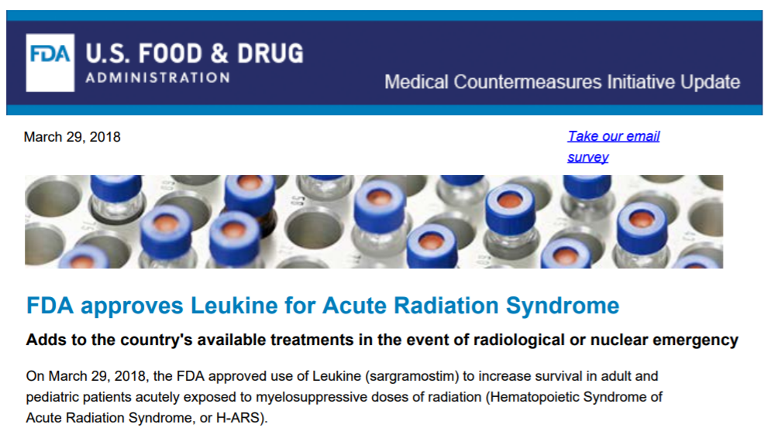
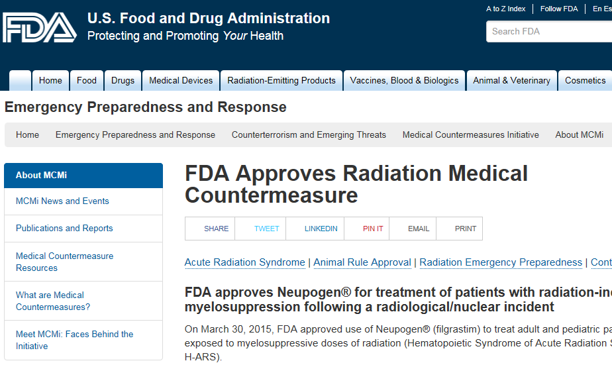
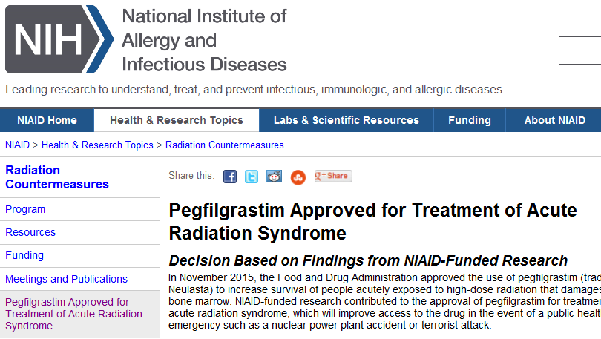
Why Everyone Should Care
Government Is Not Taking the Threat Lightly
FDA Approves for treatment of ARS
  Filgrastim (March 2015)
  Pegfilgrastim (Nov 2015)
  Sargramostim (March 2018)
  Romiplostim (January 2021)
These drugs being added to Strategic National Stockpile for a disaster
Notes:
The government feels the threat to be real, it has stockpiled medicine and modified treatment authorization to use the best medication available to treat those exposed to radiation.

Slide 3
Agenda
What is RITN?
What RITN is preparing for
How RITN fits into the response
Casualty Profile & Care
Resources

Slide 4
What is RITN?

Slide 5
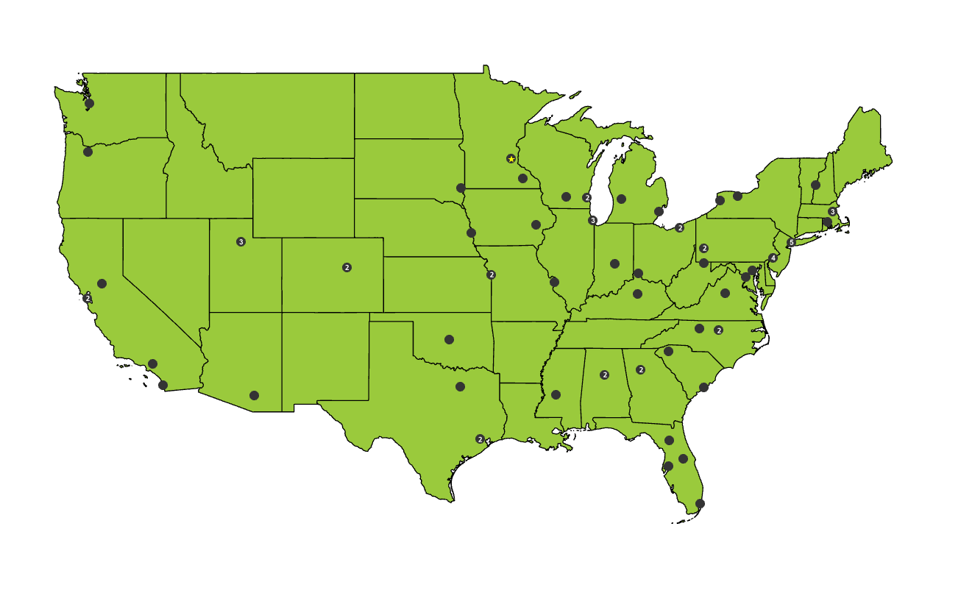
What is RITN? And why create it?
74 medical centers with expertise in the management of bone marrow failure
Notes:
What is RITN?
RITN is a collaborative effort, led by the NMDP-Be The Match and the ASTCT, of hospitals preparing for the medical surge resulting from a distant radiological incident
RITN hospitals prepare to provide specialized care to patients with Acute Radiation Syndrome (ARS) following a mass casualty radiological incident
Hospitals near the incident will not be activated as part of the RITN
RITN expertise is for “radiation only” injuries, trauma patients should be sent to other NDMS hospitals
Why was RITN Created?
The gap of specialized care for ARS patients was identified by the Assistant Secretary for Preparedness and Response, or ASPR, as well as the Office of Naval Research
Following the leadership of the Office of Naval Research, the NMDP-Be The Match was developing capacity at bone marrow treatment clinics in hospitals to prepare
In 2005 ASPR engaged the NMDP-Be The Match and American Society for Transplantation and Cellular Therapy (ASTCT) to collaborate on bridging the gap
ASTCT members are world leaders in transplantation

Slide 6
RITN Mission
Preparing to treat Acute Radiation Syndrome casualties from a distant radiological mass casualty disaster
Notes:
It boils down to a simple statement: Preparing to treat Acute Radiation Syndrome casualties from a distant radiological mass casualty disaster
Vs.
The Radiation Injury Treatment Network® (RITN) is a national network of medical centers with expertise in the management of bone marrow failure and works with partners from other medical specialties to assist with managing acute radiation syndrome (ARS) and its health-related consequences. The mission of the RITN is to maximize health-related outcomes among casualties with ARS following a mass casualty disaster involving radiological, nuclear, or chemical agents with marrow toxicity.
To accomplish its mission:
Before the disaster, RITN develops treatment guidelines for managing hematologic toxicity among casualties of radiation exposure and educates health care professionals about pertinent aspects of radiation exposure management through training and disaster exercises.
During the disaster, RITN centers provide comprehensive evaluation and treatment in both inpatient and outpatient settings. The RITN control cell helps to coordinate the response and shares critical information about the disaster between RITN hospitals and governmental agencies, including the Department of Health and Human Services (DHHS), Assistant Secretary of Preparedness and Response (ASPR).
After the disaster, RITN centers collect and share patient data for research through the Center for International Blood and Marrow Transplantation Research.
RITN is led by the National Marrow Donor Program and American Society for Transplantation and Cellular Therapy, with essential support from the US Office of Naval Research

Slide 7
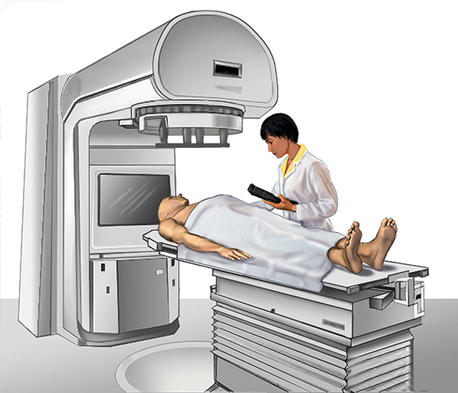
Why Cancer Centers?
Bone marrow is a the most sensitive organ in the body to ionizing radiation
Doses >2 Gy** of ionizing radiation can cause Acute Radiation Syndrome (ARS)
ARS mimics what BMT/hematology/oncology staff see daily while treating patients with blood cancers
Through cancer treatment process patients are irradiated or given chemotherapy to destroy their immune system (marrow)
Failure to restore would result in death
Image Source: NCI https://www.cancer.gov/about-cancer/treatment/types/radiation-therapy/radiation-fact-sheet accessed 11/29/16
**Chest CT = 7 mSv : ~0.007 Gy == 2 Gy ~286 chest CTs
** PET/CT = 25 mSv : ~0.025 Gy == 2 Gy ~ 80 PET/CTs
Notes:
Extremely small numbers of the long-term blood (hematopoietic) stem cells can repopulate the entire blood forming system
Survival boosts (LD50/60):
Left untreated ½ of radiation casualties will die from >3 Gy
With supportive care increase to ½ survive at 6 Gy
With Cytokines increase ½ survive at 8 Gy
Doses of ionizing radiation >2 Gy** can cause Acute Radiation Syndrome (ARS)
ARS mimics what BMT/hematology/oncology staff see daily from the treatment of blood cancers
Through cancer treatment process patients are irradiated or given chemotherapy to destroy their immune system
Dose treatment:
~< 2Gy is survivable without treatment
4 Gy is LD 50/60 without supportive care
LD 50/60 increases to ~6 Gy with supportive care (fluids, antibiotics, antifungals)
LD 50/60 increases to ~8 Gy with cytokines
Bone marrow is a the most sensitive organ in the body to ionizing radiation.
Bone marrow is the source of production of:
Red blood cells ----- for oxygen
White blood cells -- for immunity
Platelets -------------- for clotting
Failure to restore blood production following radiation injury would result in death.
Untreated, many radiation casualties will die of marrow suppression from whole body exposure greater than 300 cGy (rad).
Extremely small numbers of the long-term blood (hematopoietic) stem cells can repopulate the entire blood forming system.
Hematopoietic stem cells are primarily in the bone marrow and also circulate in the blood.
The hematopoietic stem cell, undamaged, is very sturdy and for transplantation can be obtained from a donor from the bone marrow from their hip or from the blood using apheresis.
This focus of RITN leverages the expertise of marrow transplant specialists who are accustomed to providing the intensive supportive care required by patients with suppressed marrow function.
=============
Gy to Sv conversion... Approximation: http://www.convert-me.com/en/convert/radiation/rrgray.html?u=rrgray&v=2
Chest CT dose from: http://www.radiologyinfo.org/en/info.cfm?pg=safety-xray
Conversion from: http://www.convert-me.com/en/convert/radiation/rrmsievert.html?u=rrmsievert&v=7
============

Slide 8
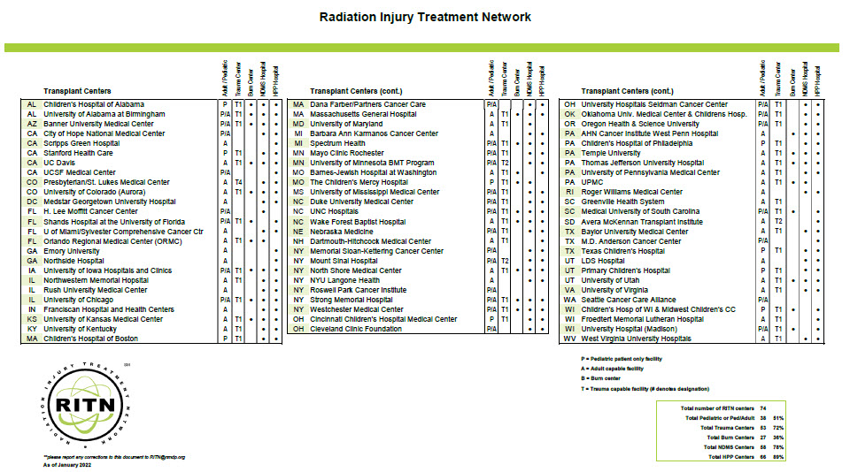
Notes:
What is RITN?
RITN is a collaborative effort, led by the NMDP-Be The Match and the ASTCT, of hospitals preparing for the medical surge resulting from a distant radiological incident
RITN hospitals prepare to provide specialized care to patients with Acute Radiation Syndrome (ARS) following a mass casualty radiological incident
Hospitals near the incident will not be activated as part of the RITN
RITN expertise is for “radiation only” injuries, trauma patients should be sent to other NDMS hospitals
Why was RITN Created?
The gap of specialized care for ARS patients was identified by the Assistant Secretary for Preparedness and Response, or ASPR, as well as the Office of Naval Research
Following the leadership of the Office of Naval Research, the NMDP-Be The Match was developing capacity at bone marrow treatment clinics in hospitals to prepare
In 2005 ASPR engaged the NMDP-Be The Match and American Society for Transplantation and Cellular Therapy (ASTCT) to collaborate on bridging the gap
ASTCT members are world leaders in transplantation

Slide 9
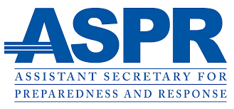



Federal Plans Involving the RITN
White House: Planning Guidance for Response to a Nuclear Detonation
FEMA: Nuclear/Radiological Incident Annex
ASPR: Radiological Dispersal Device Playbook
ASPR: Rad/Nuke Annex to All Hazards Plan
ASPR: State & Local Planners Playbook for Medical Response to a Nuclear Detonation
ASPR: Medical Planning and Response Manual for a Nuclear Detonation Incident
NLM: REMM-RITN Prototype for Adult & Pediatric Medical Orders During a Radiation Incident
Notes:
ASPR CBRNE branch in Office of Emergency Management
https://www.phe.gov/about/oem/cbrne/Pages/default.aspx
RITN has memorandum of understanding, or MOU, with ASPR to coordinate preparedness and response efforts
Work with the Chemical, Biological, Radiological, Nuclear, and high yield Explosives, or CBRNE, branch in Office of Emergency Management
www.phe.gov

Slide 10
Concept of Operations…. ConOps

Slide 11

Wikipedia, June 2011

Slide 12
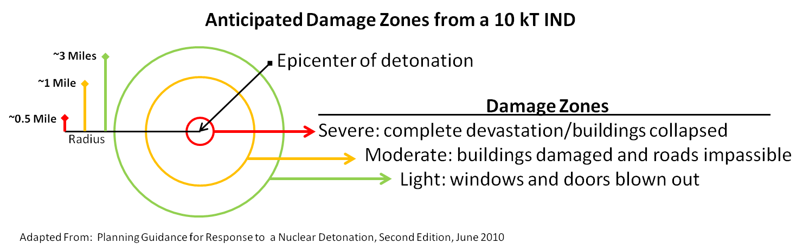
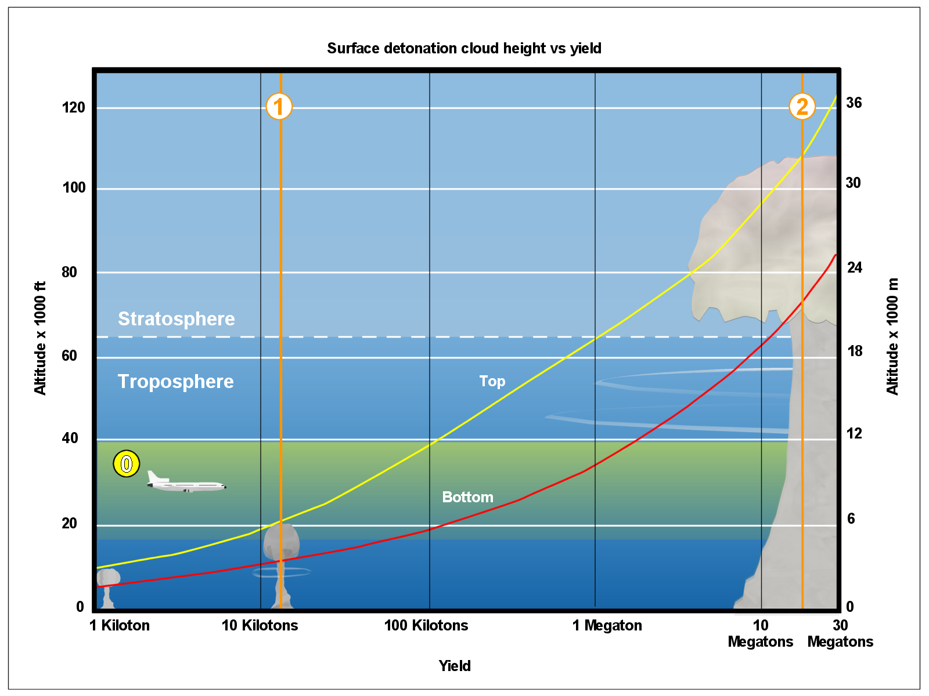
Damage will not be as Catastrophic as a Military Nuclear Weapon
Military Weapon
Terrorist Device
From: Wikipedia
Notes:
Any incident that results in mass casualties with marrow toxic injuries is RITNs focus, the most likely incident would be from the detonation of an improvised nuclear device.
Even though an RED, RDD, industrial or nuclear power plant accident could result in victims with ionizing radiation exposure these likely would not result in mass casualties. Other incidents that could involve RITN include a nuclear power plant accident, radiological exposure device (RED) a.k.a. open source, radiological Dispersal Device (RDD) a.k.a. dirty bomb, an industrial accident, military grade nuclear weapon, a chemical exposure from mustard agent or some unknown incident we have not thought of.
Megaton bombs can devastate entire cities.
However, even though a 10 Kiloton bomb would will leave a crater 500 feet across and destroy a ½ mile radius around the detonation site this level of damage quickly decreases the further away from the hypocenter (detonation site).
Fallout will be a significant issue.
The old Duck and Cover response could still help those close to the hypocenter, within 3 miles.
But it will not be the level of devastation that is generally thought of.
Current planning expects that a detonation will be less than 10 Kilotons, this is far less than the Megatons of expected yield during the cold war.
Severe zone: few buildings are expected to be structurally sound or even standing and roads will be impassible
Moderate zone: significant structural damage, blown down utility lines, overturned automobiles, some collapsed buildings, many wood frame houses will be destroyed and roads very difficult to traverse.
Light zone: some broken windows, some litter and debris in roads.

Slide 13
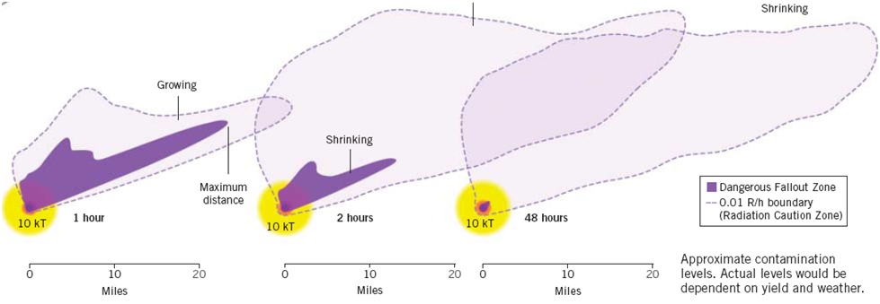
Fallout May Cause the Most Radiation Injuries
Dangerous Fallout Zone
The dose in the Dangerous Fallout zone could cause marrow injury
Sheltering-in-place is key to reducing dose, as the hazard dissipates relatively quickly
Illustration from: Knebel AR, Coleman CN, Cliffer KD; et al. Allocation of scarce resources after
a nuclear detonation: setting the context. Disaster Med Public Health Prep. 2011;5 (Suppl 1):S20-S31
Notes:
Illustration of the Dangerous Fallout zone from the ground burst detonation of an IND. The dose in the Dangerous Fallout zone could cause marrow injury. Sheltering-in-place is key to reducing dose, as the hazard dissipates relatively quickly.
A hazard to many more people will be the radiation from fall out. However, this dissipates quickly. Within 12 hours the dangerous fallout zone in dark purple on the left image is expected to shrink back to within 3 miles of the detonation site.
This means if people take shelter, they should be able to minimize their level of exposure and limit the dose of radiation they receive.
The image on the right depicts the increased protection a person gains from different shelter locations…. A person in a basement of a wood house will receive 1/10th the exposure of someone who is outside or even sitting in a vehicle.
In the end, the point is that it is not the end of the world; many, many people will survive.

Slide 14
It is not the Cold War….. Nor is it a futile effort
Notes:
Too many people involved with preparedness for a radiological disaster immediately give up assuming that if a bomb were detonated in their community everyone would be dead; this stems from the perception from the Cold War where the USSR would detonate a 30-megaton device over a US city. This is multiple orders of magnitude larger than the 10kT device expected to be detonated by a terrorist organization.

Slide 15
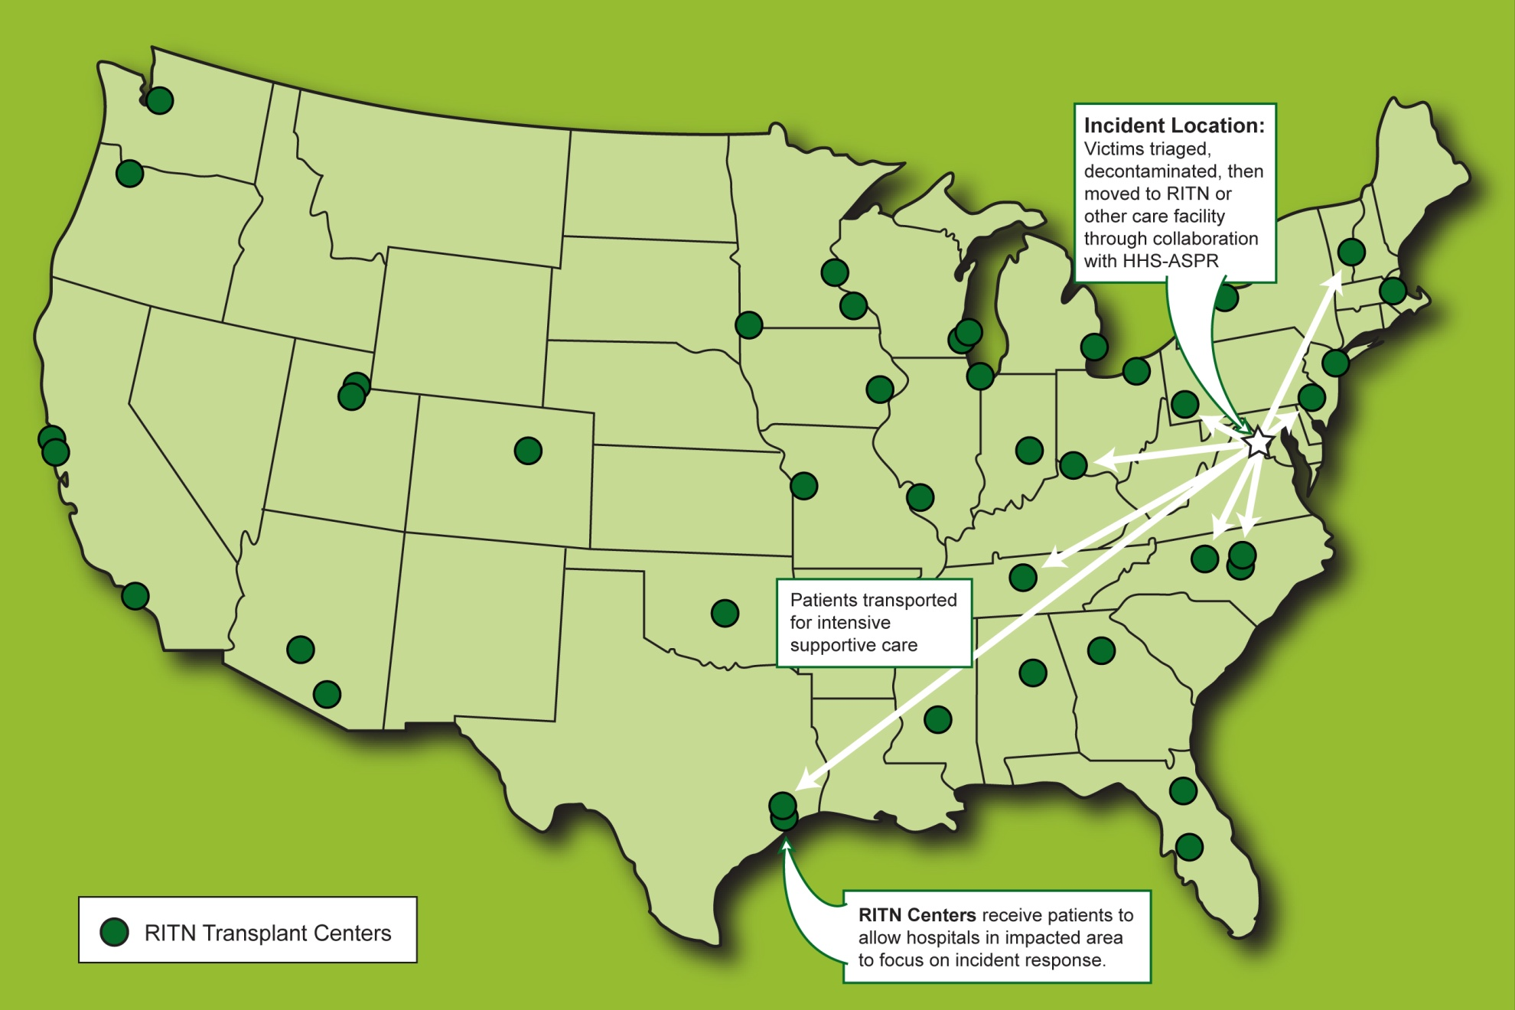

Movement of patients through NDMS
Notes:
RITN centers plan to receive patients from the impacted area
RITN centers are not first responders or a local response asset
If an RITN center is near a disaster site it will be too busy handling the immediate surge to be preparing to receive additional radiation victims.
However, other RITN centers could receive existing patients from a RITN center near a disaster site as patients are offloaded to accommodate the medical surge.

Slide 16
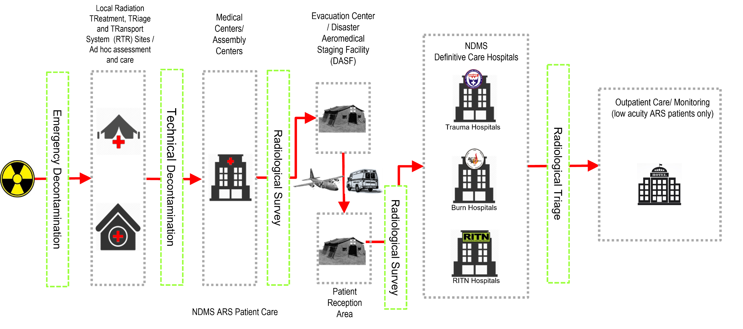
ARS Patient Movement
Notes:
Bottom-line is that all of this will take time for the casualties to arrive at a RITN hospital… ~7-10 Days.
Casualties will be triaged and grossly decontaminated near the disaster then distributed when necessary to distant hospitals for appropriate care.
The boldness of the arrows decreases the further from the incident site as the casualties that are passed on to the next level of care decrease at each stage in the process.
Despite the magnitude of a disaster like this, RITN centers will have time before casualties arrive, possibly a week or more.
And there will be even more time to determine if a casualty requires a transplant, up to four weeks after exposure.

Slide 17
Only a small percentage would likely benefit from a transplant
Notes:
10% of the casualties will have radiation injuries only.
Of those casualties, 29% will likely require inpatient care
Only 1% will likely be candidates for a marrow transplant.
The remaining 70% will need daily CBCs and minimal supportive care to monitor their recovery; ideally in an outpatient setting.

Slide 18











RITN Estimated Patient Profile
Total IND Casualties: 588,000
Expected Patient Care
Requirements for RITN Patients
Breakdown of Expected Radiation Only
Casualties for RITN Hospitals
Breakdown of
estimated casualties
1%
Marrow transplant candidates
630
60%
10%
29%
Intensive inpatient supportive care
18,270
of casualties will have trauma only
of casualties will have moderate to severe radiation only injuries (ARS) & be sent to RITN hospitals for definitive medical care
Increasing level of severity
70%
Outpatient
complete
blood count
monitoring
44,100
8%
15%
7%
of casualties will be triaged as expectant due to severe ARS
of casualties will have mild ARS & only need to be monitored
of casualties will have combined trauma & radiation injuries and need to be stabilized before involving RITN
*based on estimates from:
Knebel AR, Coleman CN, Cliffer KD; et al. Allocation of scarce resources after a nuclear detonation: setting the context. Disaster Med Public Health Prep. 2011;5 (Suppl 1):S20-S31
Notes:
Those with ARS will need specialists. Approximately 10% will have ARS, they will need specialized supportive care to survive, care given every day at cancer centers around the world.** There is an additional 7% that will have combined trauma and radiation injuries that once stabilized for their trauma will require consultation with a RITN hospital for care of their ARS.
With Radiation exposure only victims with 2-6 Gy are likely to survive with specialized supportive care. Those with less than 2 Gy of exposure should not require significant medical resources for their care, they will self recover or survive with outpatient care.
The pyramid of treatment illustrates the small percentage of casualties with “radiation only” marrow-toxic injuries that likely would be moved through NDMS to RITN centers calculated from Knebel AR, Coleman CN, Cliffer KD; et al. Allocation of scarce resources after a nuclear detonation: setting the context. Disaster Med Public Health Prep. 2011;5 (Suppl 1):S20-S31
The composition of casualties is very difficult to estimate. This figure conveys the point that the majority of casualties will require supportive care, frequently as an outpatient. The percentages shown here are an estimate determined by RITN based on interpretation of current publications and medical experience.
Casualty Estimates adapted from ground burst 95th%tile column: Knebel AR, Coleman CN, Cliffer KD; et al. Allocation of scarce resources after a nuclear detonation: setting the context. Disaster Med Public Health Prep. 2011;5 (Suppl 1):S20-S31
Those needing transplant estimated based on:
Dainiak N, Chao N, Weinstock D, et al. Literature review and global consensus on management of acute radiation syndrome affecting nonhematopoietic organ systems. Disaster Med Public Health Prep. 2011 Oct;5(3):183-201. doi: 10.1001/dmp.2011.73. Epub 2011 Oct 10.
Dainiak N, Chao N, Weinstock D, et al. First global consensus for evidence-based management of the hematopoietic syndrome resulting from exposure to ionizing radiation. Disaster Med Public Health Prep. 2011 Oct;5(3):202-12. doi: 10.1001/dmp.2011.68. Epub 2011 Oct 10.

Slide 19
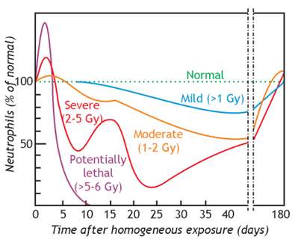
With Acute Radiation Syndrome There is Time
ARS takes time to progress
Even potentially lethal doses (purple) take days to develop
With severe doses (red) the casualties could have up to three weeks for the full illness to mature
From: EBMT Pocket Guide October 2017 - European approach for the Medical Management of Mass Radiation Exposure Therapeutical Management
Notes:
With ARS there is time before the casualties symptoms fully develop.
Patients with this syndrome can manifest one or more sub-syndromes depending on the dose of radiation received.
The higher the dose received the more severe the illness and the earlier the onset of clinical manifestations
Patients who are transferred to a RITN center are those who are likely to develop the Hematopoietic subsyndrome of ARS (H-ARS)
Currently, patients who develop the gastrointestinal or the neurovascular sub-syndromes of ARS are not likely to survive
The presence of comorbid injuries or concomitant trauma or burns will greatly increase the severity of the illness and worsen the prognosis for recovery
Bone marrow sub-syndrome
Also referred to as hematopoietic syndrome or H-ARS)
The primary cause of death is the destruction of the bone marrow, resulting in infection and hemorrhage
Cutaneous sub-syndrome
Usually accompanied by some skin damage
It is also possible to receive a damaging dose to the skin without symptoms of ARS (e.g. Beta burns)
Gastrointestinal (GI) sub-syndrome
Survival is extremely unlikely with this syndrome. Destructive and irreparable changes in the GI tract and bone marrow usually cause infection, dehydration, and electrolyte imbalance. Death usually occurs within 2 weeks.
Cardiovascular (CV)/ Central Nervous System (CNS) sub-syndrome
Death occurs within 3 days. Likely due to collapse of the circulatory system as well as increased intracranial pressure.

Slide 20
RITN ARS Treatment Guidelines full guidelines @ www.RITN.net/treatment
Follow standard approaches for patients with bone marrow toxicity from chemotherapy
Based on severity of cytopenias and presence of complications (e.g. neutropenic fever)
  Irradiated, leukoreduced transfusions
  Antibiotics
  IV fluid and other support
  G-CSF
  Hospitalization when indicated
Daily CBCs to determine clinical need for treatment
Biodosimetry
  Using online algorithms (REMM & BAT)
  Blood counts (before and after arrival at RITN centers)
  Geographic dosimetry
  Opportunity to apply new biodosimetry approaches
Notes:
Approaches to care are not new
Clinicians and RITN bone marrow transplant centers are experts in treatment of these symptoms
Possibility of implementing new mitigation approaches based on the governments efforts to develop medical countermeasures

Slide 21
Resources

Slide 22
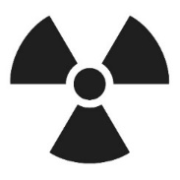




RITN Preparedness Efforts…. Exercises, Training and More….
Since 2006
881 exercises
***All exercise materials available on RITN.net/exercises
19,716 medical staff trained
***Free web-based courses available on RITN.net
Doses on-hand
16,700+ G-CSF & 1100+ GM-CSF doses
1600+ Romiplostim doses
***Fluctuates throughout year, is sum of inventory at each RITN hospital
7,388 Adult & 2,425 ped ARS beds w/in 24 hrs *** as of February 2022
74 hospitals and cancer centers
Notes:
RITN connected the willing with the resources necessary so they could prepare. Coordinating exercises, training and tracking of medical resources.**
The exercises RITN has conducted include mostly tabletop exercises where we provide a scenario and discussion questions for each hospital, and they review them in a low stress meeting type environment. Then they submit their answers to the discussion questions online. We post all of these exercises and summary data on RITN.net/exercises. In 2014 we began providing funding to hospitals to conduct functional and full-scale exercises which activate portions of a response plan or the entire plan including partner organizations respectively.

Slide 23
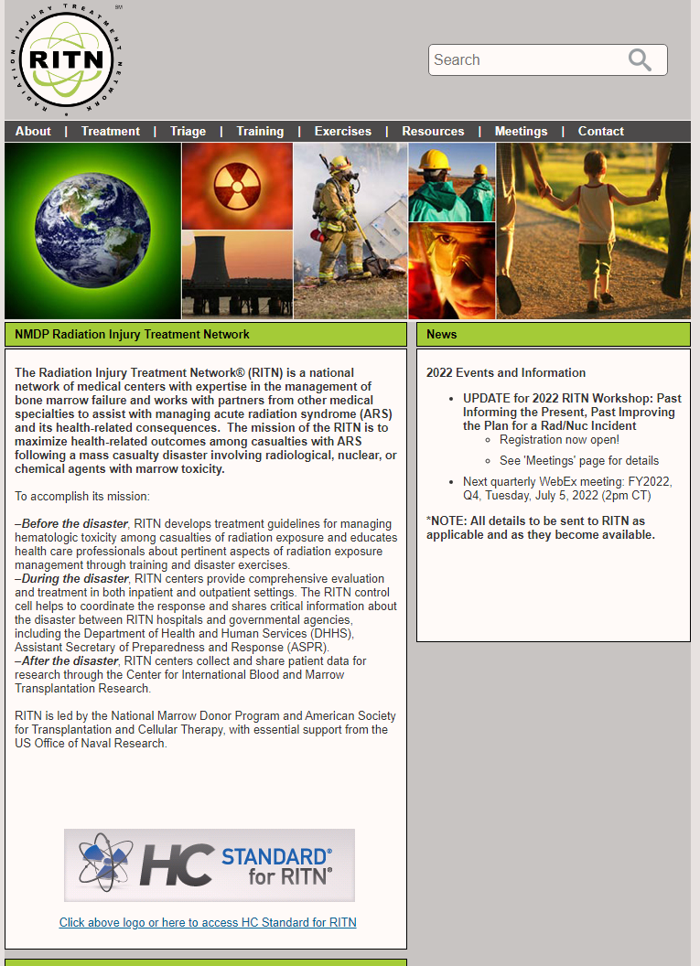
Resources
Medical Guidance www.RITN.net/treatment
  ARS Treatment Guidelines
  Referral Guidelines
  Adult and Pediatric Medical Orders in collaboration with REMM
Training www.RITN.net/training
  Mobile REAC/TS course
  ARS Medical Grandrounds training
  Web based training courses (basic radiation, ConOps, etc...)
  Non-medical Radiation Awareness Course Adopted by NNSA for USAID staff
Operations
  Exercises
  Web based data collection for ARS patients
  RITN hospital “bed report +” integrated into GEO Health
Notes:
MOU with ASPR
Medical Guidance www.RITN.net/treatment
ARS Treatment Guidelines
Referral Guidelines
Adult and Pediatric Medical Orders in collaboration with REMM
Training www.RITN.net/training
Mobile REAC/TS course
ARS Medical Grandrounds training
Web based training courses (basic radiation, ConOps, etc...)
Non-medical Radiation Awareness Course Adopted by NNSA for USAID staff
Operations
Web based data collection for ARS patients
RITN hospital “bed report +” integrated into GEO Health
Federal Plans Involving the RITN
White House: Planning Guidance for Response to a Nuclear Detonation
FEMA: Nuclear/Radiological Incident Annex
ASPR: Radiological Dispersal Device Playbook
ASPR: Rad/Nuke Annex to All Hazards Plan
ASPR: State & Local Planners Playbook for Medical Response to a Nuclear Detonation
ASPR: Medical Planning and Response Manual for a Nuclear Detonation Incident
NLM: REMM-RITN Prototype for Adult & Pediatric Medical Orders During a Radiation Incident

Slide 24

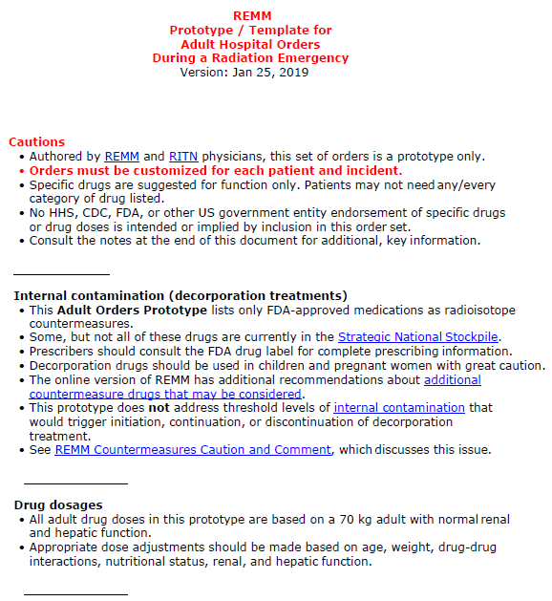
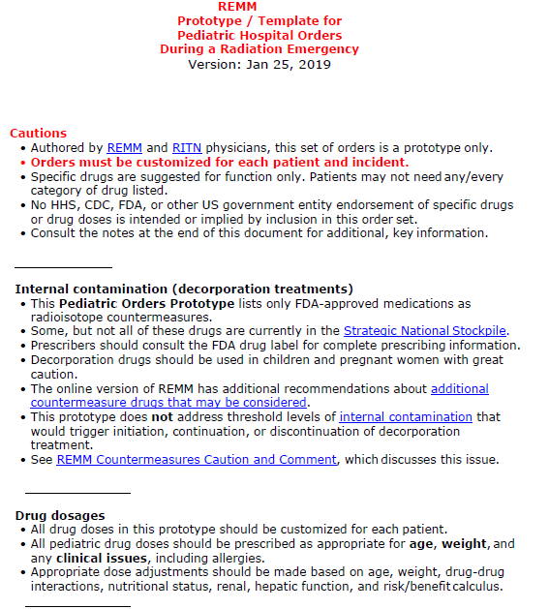
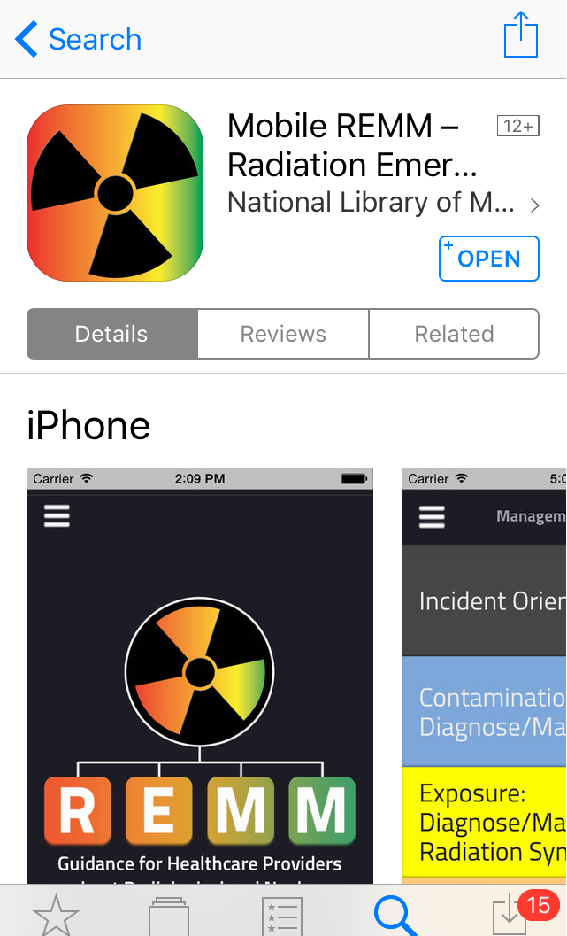
Adult & Pediatric Medical Orders: REMM.HHS.GOV & RITN.net/treatment
Adult Medical Orders
Pediatric Medical Orders
www.REMM.HHS.gov

Slide 25
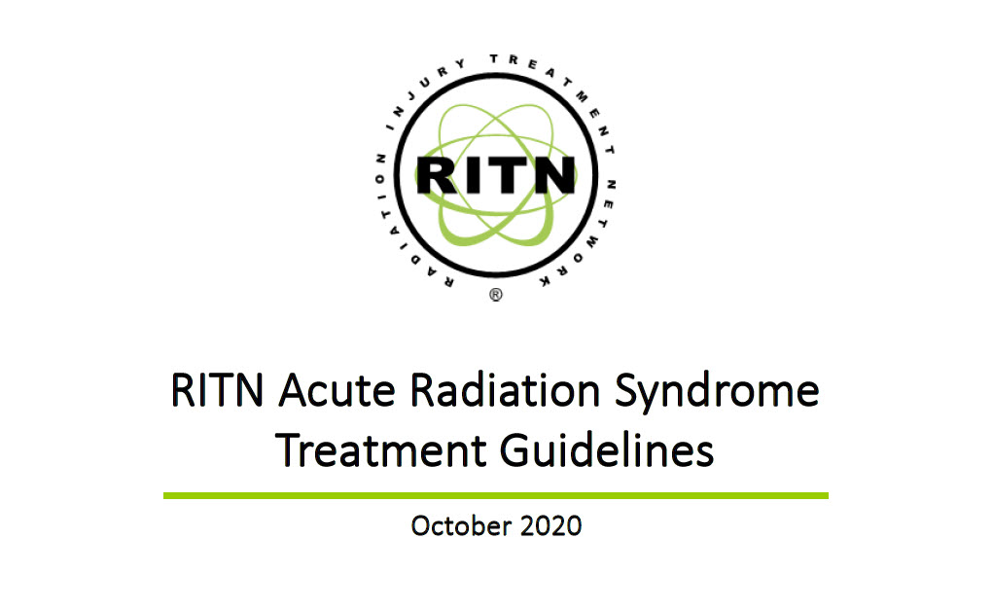
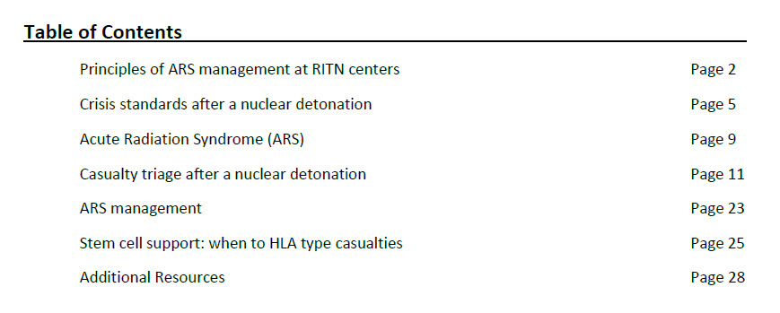
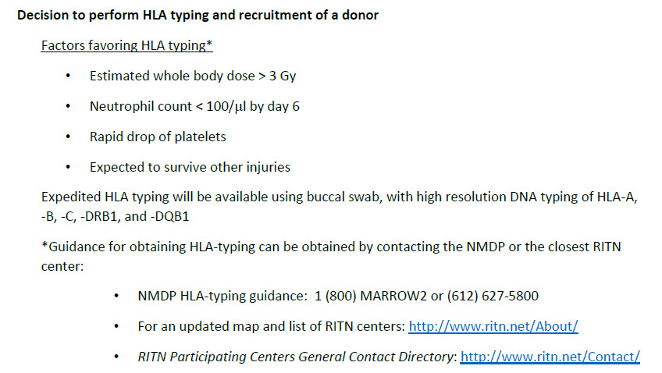
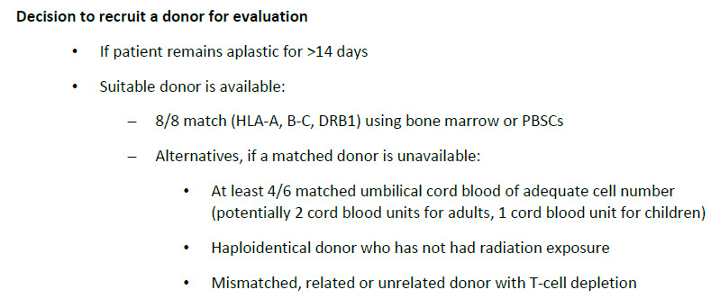
Treatment Guidelines on RITN.net/treatment

Slide 26
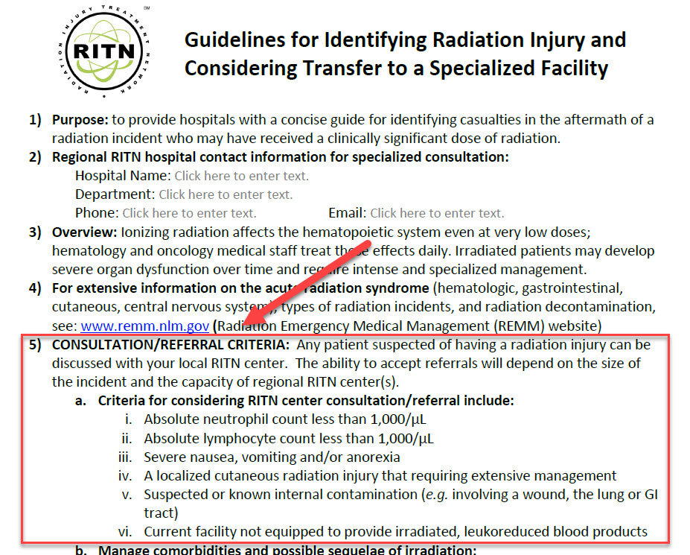
Referral Guidelines: www.RITN.net/triage

Slide 27
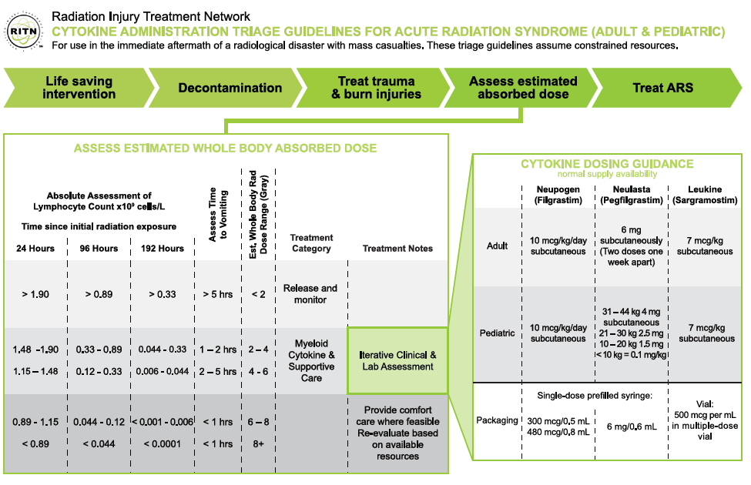
Cytokine Triage Guidelines: www.RITN.net/triage/
Cytokine Administration Triage Guidelines for Acute Radiation Syndrome (Adult and Pediatric)
Sizes to download:
  4”x6”
  8.5” x 11”
  24” x 36”

Slide 28
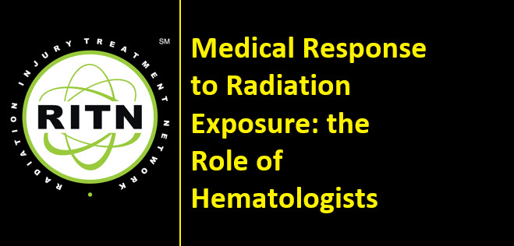
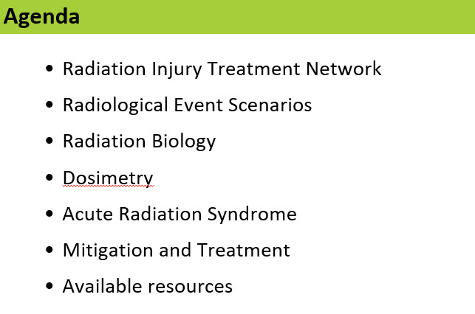
Training: Medical Grand Rounds on RITN.net/training

Slide 29
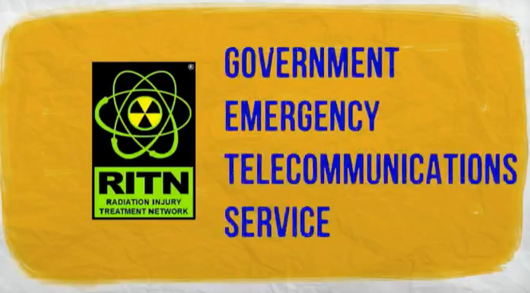
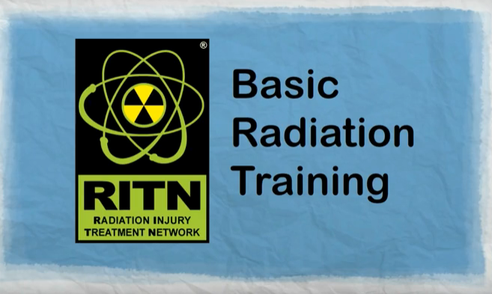
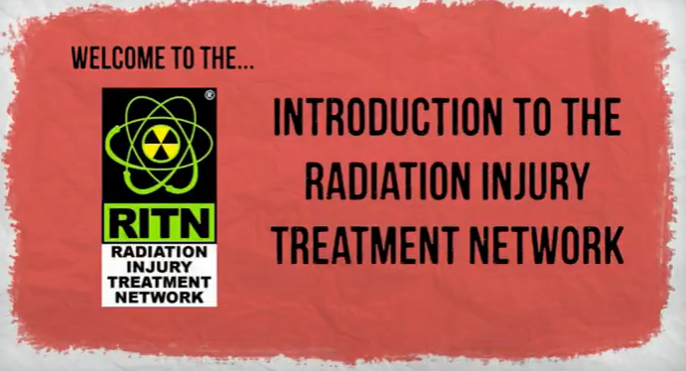
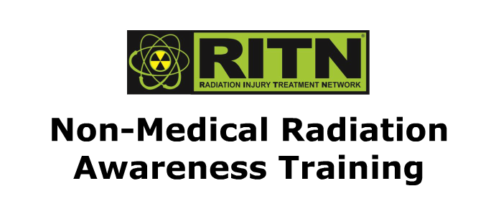
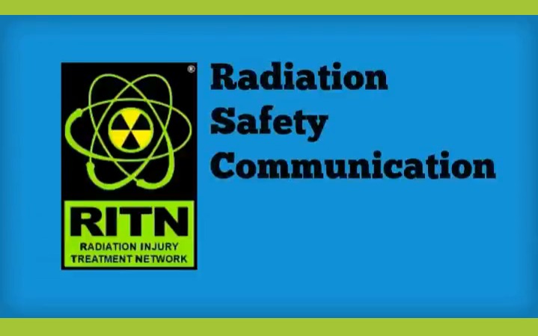
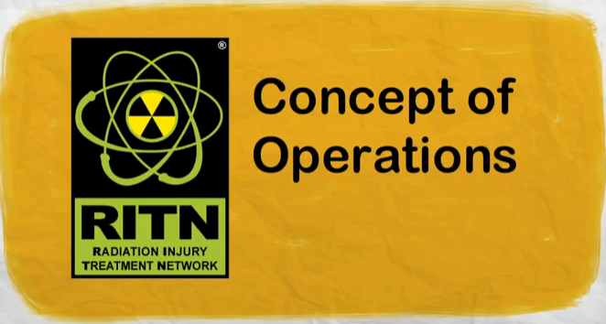
Web Based Training on RITN.net/training (FREE TRAINING)
Web based training
  Intro to RITN
  Basic Radiation Training
  RITN Concept of Operations
  Radiation Safety Communication
  GETS Card 101
  Non-Medical Radiation Awareness Training (ESL)
Medical Grand Rounds training
Adopted by NNSA for USAID training

Slide 30
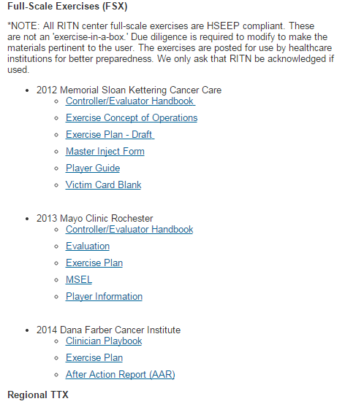
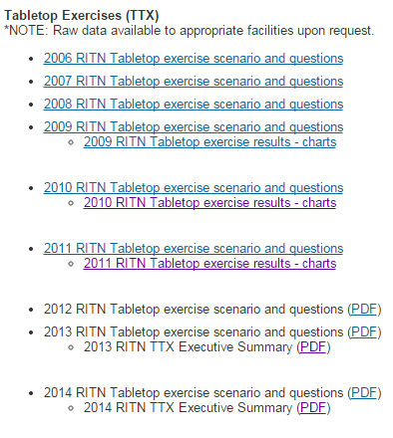
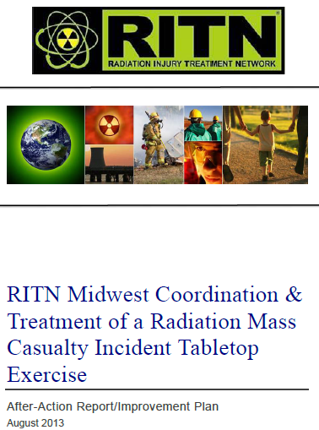
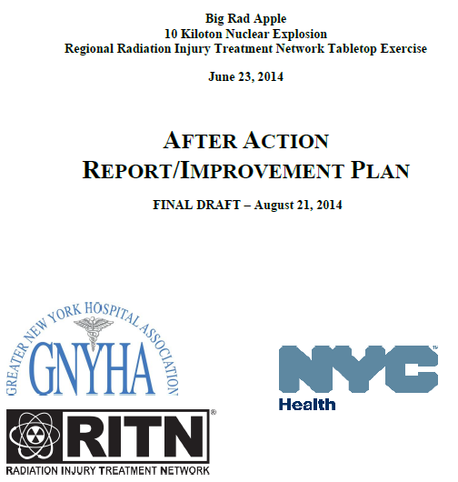
Exercise Materials on RITN.net/exercises
Tabletop SITMANs (16 years of exercises and results)
Regional Tabletop and Full-scale exercise materials
Data from exercises
AARs

Slide 31
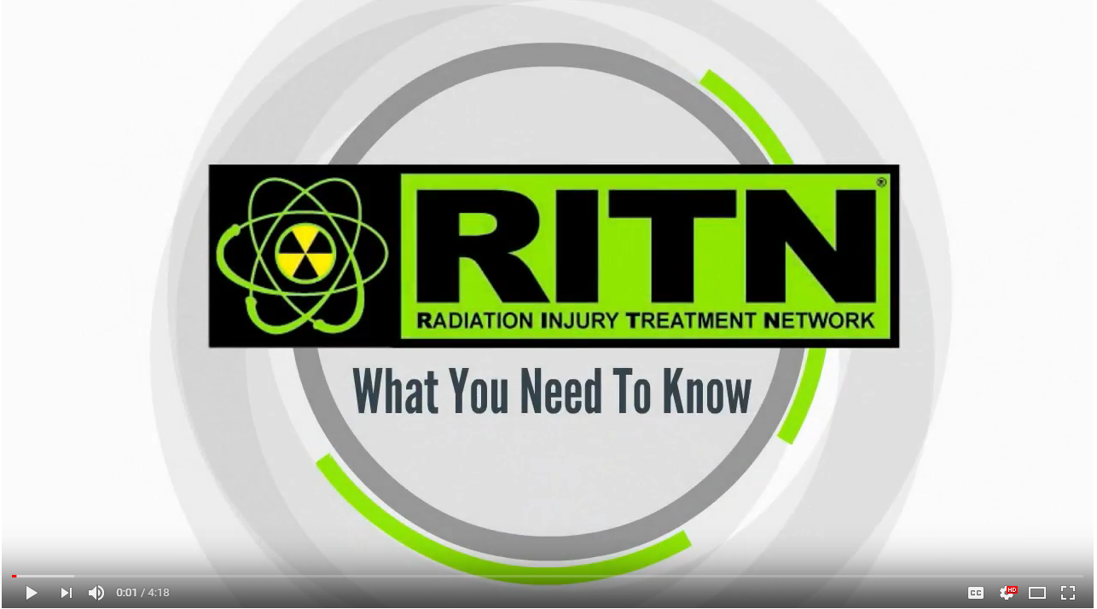
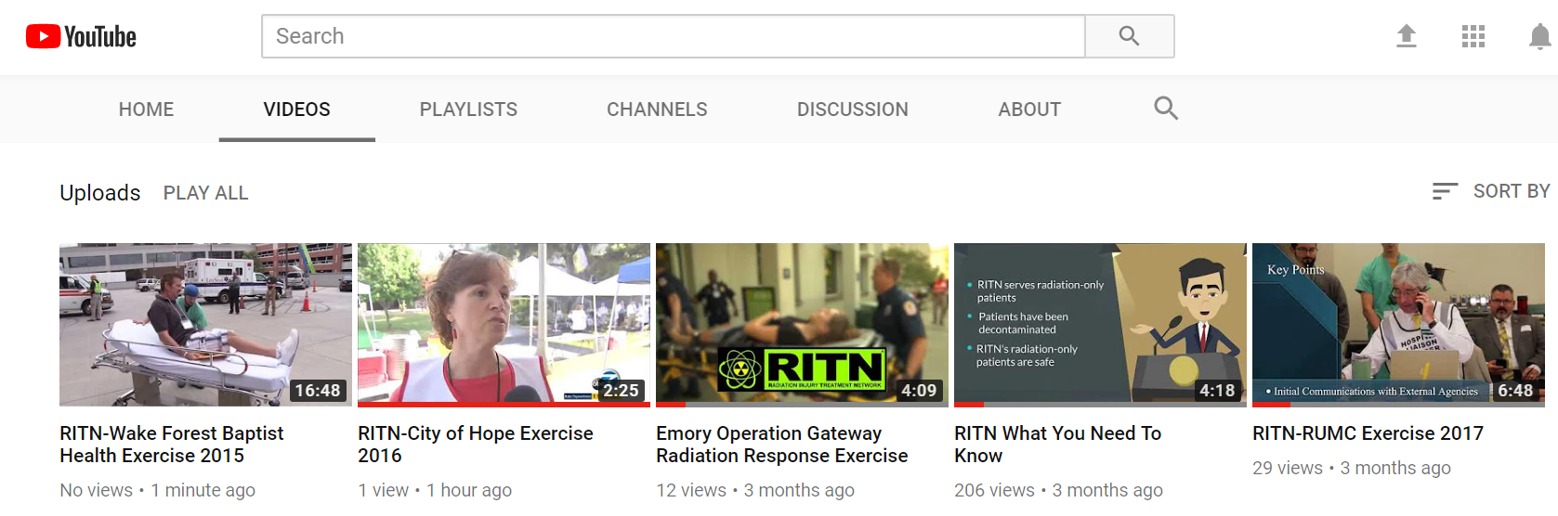
RITN YouTube Channel https://www.youtube.com/watch?v=v-qW-z7qXRw
RITN What You Need to Know (Video): 4 min overview video
+
Exercise videos
Just-in-Time Training
videos
Notes:
https://www.youtube.com/watch?v=v-qW-z7qXRw

Slide 32
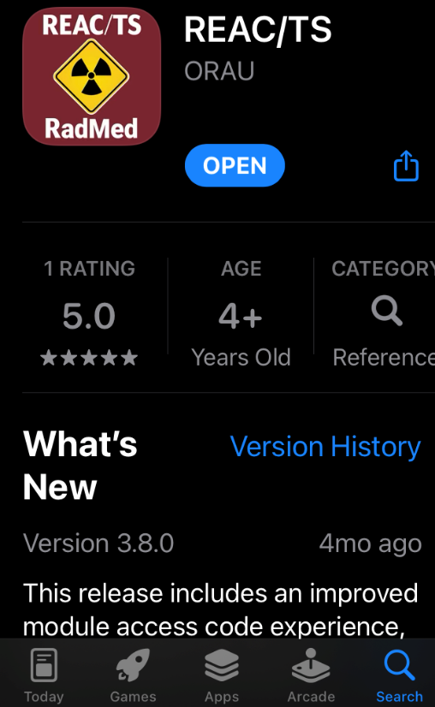
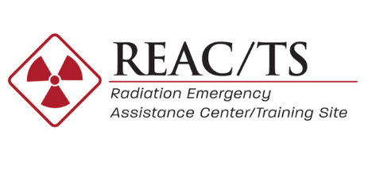
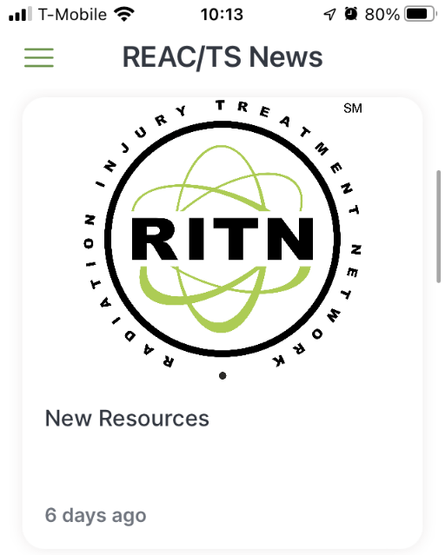
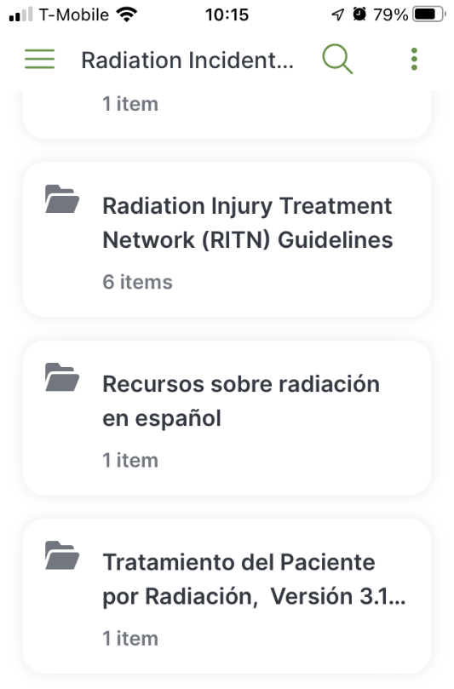
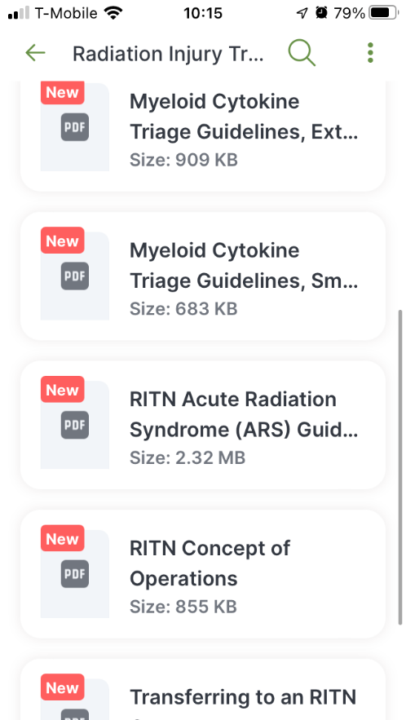
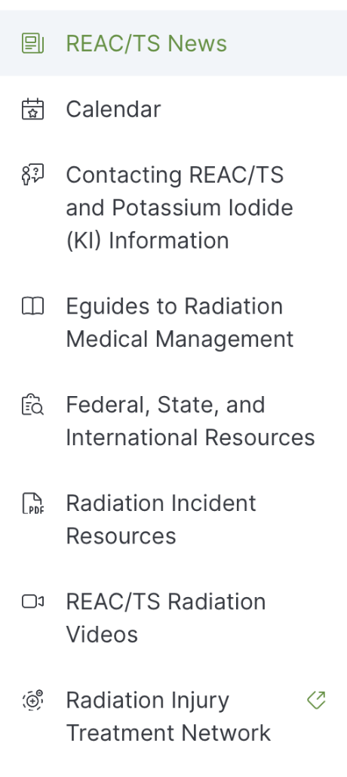

RITN Added to REACT/TS App
Radiation Emergency Assistance Center/Training Site (REAC/TS)
www. https://orise.orau.gov/reacts/index.html
Notes:
The Radiation Emergency Assistance Center and Training Site (REAC/TS) is located outside Knoxville, TN and has been providing crisis response to radiological accidents since 1976. REAC/TS staff include physicians and health physicists. REAC/TS maintains a stockpile of decorporation agents as well.
I suggest you also familiarize yourself with their website. They have an APP in the Apple store and the Android store, and there are links to RITN found here as well.

Slide 33
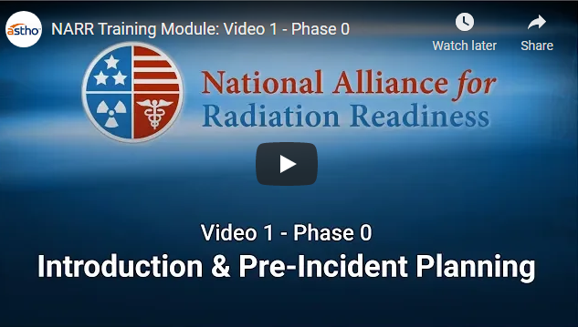
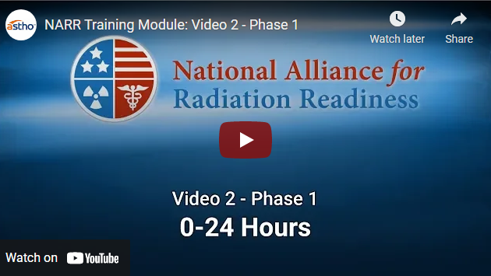
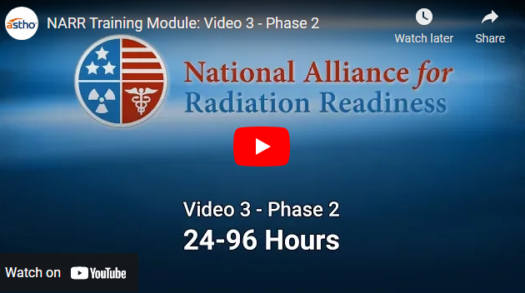
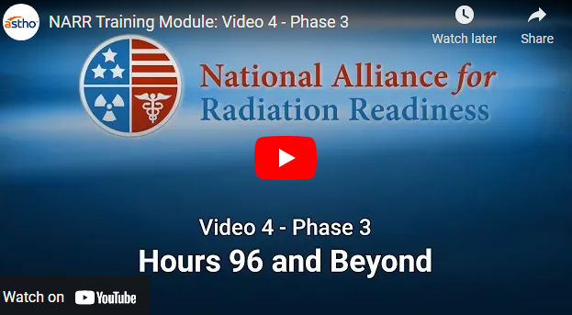
Radiation Readiness Radiation Training for Public Health
National Alliance for Radiation Readiness Radiation Training Modules for Public Health
  https://www.radiationready.org/posted-tools/national-alliance-for-radiation-readiness-radiation-training-modules-for-public-health/

Slide 34
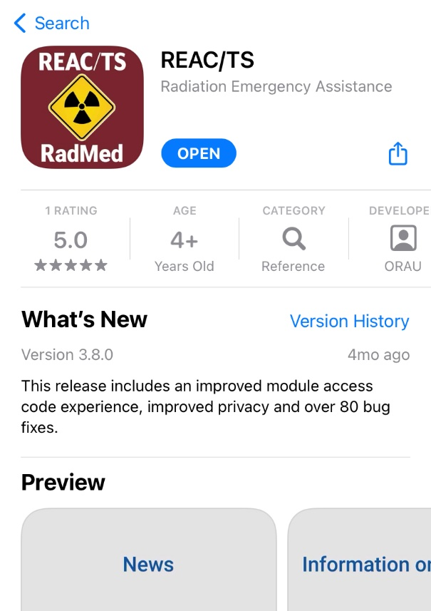
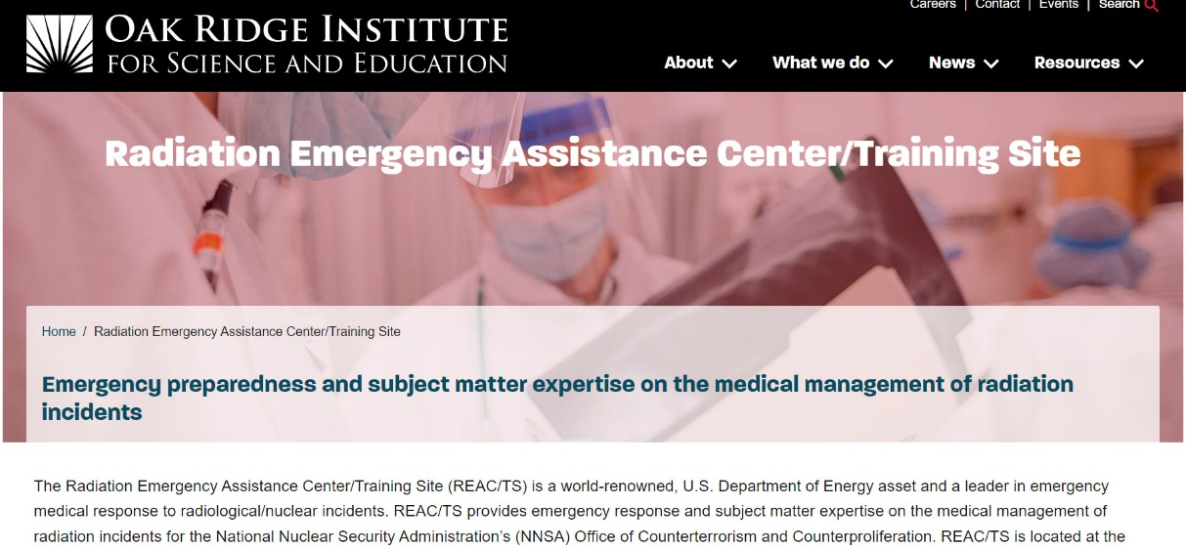
Resources continued
Radiation Emergency Assistance Center/
Training Site (REAC/TS)
www. https://orise.orau.gov/reacts/index.html
Downloadable from Google Play or the App Store
Notes:
The Radiation Emergency Assistance Center and Training Site (REAC/TS) is located outside Knoxville, TN and has been providing crisis response to radiological accidents since 1976. REAC/TS staff include physicians and health physicists. REAC/TS maintains a stockpile of decorporation agents as well.
I suggest you also familiarize yourself with their website. They have an APP in the Apple store and the Android store, and there are links to RITN found here as well.

Slide 35




















Critical to Success
Partners
National Institute of Allergy and Infectious Diseases (NIAID), Radiation and Nuclear Countermeasures Development Program (RNCP)
35
Notes:
RITN has worked to develop partners that also are preparing for similar incidents as well as professional organizations that can assist in getting the word out about the importance of preparedness for mass casualty incidents that result in marrow toxic injuries.
American Society for Blood and Marrow Transplantation
Department of Defense - Office of Naval Research
Dept. of Health & Human Services-Asst. Sec. for Preparedness & Response
Health Resources and Services Administration
Radiation Emergency Medical Management website: www.remm.nlm.gov
National Assoc. of City and County Health Officials
Assoc. of State and Territorial Health Officials
National Alliance for Radiation Readiness www.radiationready.org
AABB-Disasters Task Force
Radiation Emergency Assistance Center/Training Site
New England Center for Emergency Preparedness
European Group for Blood and Marrow Transplantation-Nuclear Accident Committee
Center for International Blood and Marrow Transplant Research

